Slide 1
Neurological
Assesments & Tests

Slide 2
A thorough neurologic assessment will include assessing mental status, cranial nerves, motor and sensory function, pupillary response, reflexes, the cerebellum, and vital signs.

Slide 3
Compare your findings to those of previous exams.
Through comparison
you'll be able to spot changes and trends and, when necessary, intervene quickly and appropriately.

Slide 4
A bedside neuro exam is done as part of the change-of-shift report, so that the off-going and oncoming nurses can assess the patient together.

Slide 5
Central Nervous System
Brain
Spinal cord
Peripheral Nervous System
Cranial Nerves
Spinal Nerves
ANS

Slide 6
Peripheral Nervous System
12 Pairs of
Cranial Nerves
Originate in the brain
Control many activities in the body
Take impulses to and from the brain
3 entirely sensory I II VIII
5 motor III IV VI XI XII
4 mixed V VII IX X

Slide 7
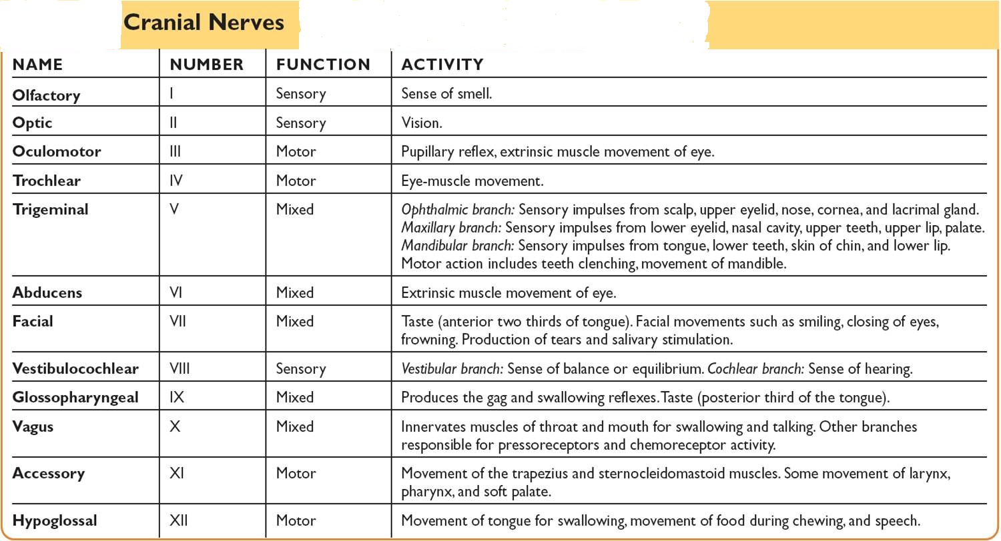

Slide 8
Spinal Nerve
31 Pairs
8 C
12 T
L
S
1Coxygeal

Slide 9
Assesment
An important aspect of the neurologic assesment
Is the history of the present illness
Depending on the patient’s condition ,the nurse may rely on yes or No answer
A review of medical record
Witness
Family
Combination

Slide 10
Assessment
Headache
Sezures
Diziness & vertigo
Visual disturbances
Muscle weakness
Abnormal sensation
Numbness
Loss of consciousness
Tremors or involuntary movements
Symptoms

Slide 11
Assesment
Onset
Location
Duration
Character
Associated symptoms
Relieving/aggravating
Time
Severity
History

Slide 12
Assesment
Testing cranial nerves
Testing Motor function
Testing Sensory function
Testing Reflexes
(Always consider left to right symmetry)
Physical assessment

Slide 13
Observing
mental status, speech, and language
sensorium, memory, thinking ability, mood, emotional state, perceptions, thought processes, ability to make judgments

Slide 14
Altered Level of Conciousness
Patient who is
Not oriented
Does not follow commands
Or needs persistant stimuli to achieve a state of alertness

Slide 15
The cause may be
Neurologic
Toxicologic
Metabolic

Slide 16
Altered Level of Conciousness
Clinical manifestation
As the patient’s allertness and conciousness
Decrease
Changes occur in
Pupillary, Eye opening,Verbal, & Motor response

Slide 17
Evaluation of level of consciousness (LOC) and mentation are the most important parts of the neuro exam.
A change in either is usually the first clue to a
deteriorating condition.

Slide 18
The Glasgow Coma Scale (GCS) is used in assessing LOC.
It's especially useful for evaluating patients during the acute stages of head injury.

Slide 19
A GCS score is based on three patient responses:
Eye opening,
Motor response,
and verbal response.

Slide 20
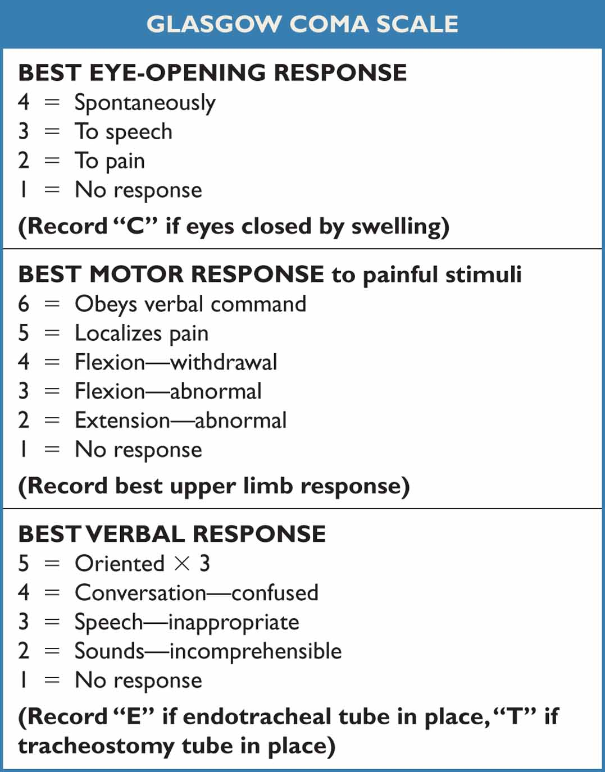
Areas of the Neurologic System Assessment-Additional assessments

Slide 21
Score 3-15
A score of 3 =sever impairment
A score of 15 =fully responsive

Slide 22
Common diagnostic procedures used to identify the cause of unconsciousness include
CT MRI
EEG

Slide 23
Nursing diagnosis
Ineffective air way clearance
Risk of self injury
Inability to take oral feeding
Impaired oral mucosa
Impaired skin integrity
Corneal injury
Risk of hypothermia
Urinary tract problems
Bowel impairment
Family crises

Slide 24
Motor function
Observation of gait and balance
Ask the client to walk across the room and return
Administration of the Romberg test
Administration of the finger-to-nose test
Observation of rapid alternating action movements

Slide 25
If the patient is alert or awake enough to answer questions,
Assess mentation. Determine if he is oriented to person, place, and time by asking questions like: What is your name? Where are you right now? Why are you here? What year is it? Who is the president?

Slide 26
Pupils are another important component of the neuro exam. Assessing them is especially important in a patient with impaired LOC. Like a change in LOC, a change in pupil size, shape, or reactivity can indicate increasing intracranial pressure (ICP) from a mass or fluid

Slide 27
Assessing for Signs of Motor Dysfunction-
Unconscious Patient Assess motor response in an unconscious patient by applying a noxious stimulus and observing the patient's response to it.
Another approach is central stimulation, such as sternal pressure. Central stimulation produces an overall body response and is more reliable than peripheral stimulation.
The reason: In an unconscious patient, peripheral stimulation, such as nail bed pressure, can elicit a reflex response, which is not a true indicator of motor activity.

Slide 28
Assessing Deep Tendon, Superficial, and Brain Stem Reflexes
Assess brain stem reflexes in stuporous or comatose patients to determine if the brain stem is intact. (You'll check for the protective reflexes—coughing, gagging, and the corneal response—as part of the cranial nerve assessment.)

Slide 29
Areas of the Neurologic System Assessment
Sensory function
Observation of light touch identification
Sharp, dull determination
Stereognosis
Graphesthesia (Number identification)

Slide 30
Areas of the Neurologic System Assessment
Reflexes (Stimulus-response activities of the body)
Biceps
Triceps
Brachioradialsis
Patellar (knee)
Achilles
Plantar (Babinski).
Abdominal

Slide 31
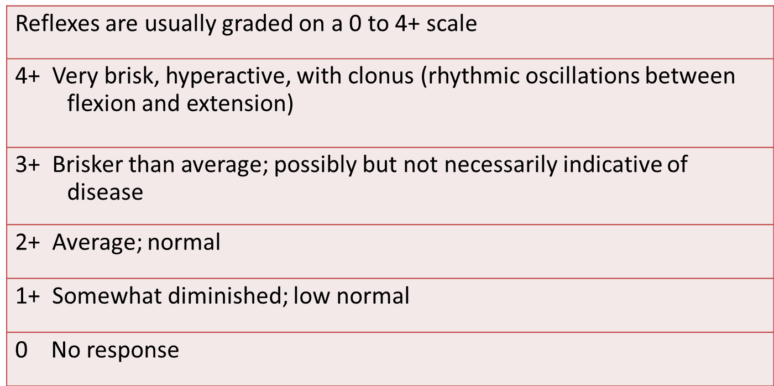
REFLEXES: SCALE FOR GRADING

Slide 32
Intra-Cranial Pressure
Pressure exerted by the volume of intracranial contents within the cranial vault

Slide 33
Intra-Cranial Pressure
Factors Affecting
Blood Volume 75ml
Brain Tissue 1400g
CSF 75ml
Normal ICP 0-10
15 mmHg upper limit of normal

Slide 34
Monro-kellie hypothesis :
Because of limited space of cranium ,an increase in any one of the components causes increase in the other

Slide 35
Raised ICP affect many patients with acute neurologic conditions
Elevated ICP is most commonly associated with head injury
May be seen in other conditions
Elevated ICP causes decrease CPP
CPP= MAP- ICP

Slide 36
Cerebral response
Compensotory
Normal CPP 70-100mmHg
Autoregulation ( the brain can maintain a steady PP if arterial presure is 50-150 mmHg
CPP below 50 mmHg = neurologic damage
A clinical phenomena known as Cushing’s reflex is seen when CPP decrease significantly
Increase blood pressure , bradycardia , widening of pulse pressure. It is a late sign requiring immediate intervension

Slide 37
Bradycardia ,hypertension and bradyapnea
= cushing’s traid
nursing allert : the earliest sign of raised ICP is
Change in LOC
Slowing of speech
Delay verbal response

Slide 38
Any sudden change in patient condition such as
Restlessness
Confusion
Or increase drowsiness
Has neurologic significant

Slide 39
ICP produces a specific set of changes known as Cushing's triad. Present in herniation syndromes, Cushing's triad consists of: increasing systolic blood pressure with a widening pulse pressure, bradycardia, and bradypnea.
Cushing's triad is a late sign of increased ICP. Once this pattern of vital signs occurs, brain stem herniation is already in progress and it may be too late to reverse it. To detect increasing ICP before it reaches this point, be alert for earlier signs: a subtle change in LOC or pupils, for example.

